Slide 1
Data Analytics - Group 7
Factors Lead to Heart Disease

Slide 2
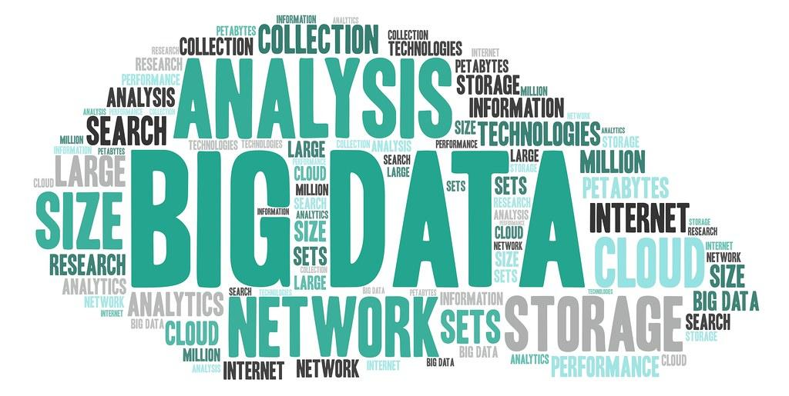
CONTENTS
Objective
Overview
Data Sources
Analytical Questions
Predictive Analytics
Conclusion

Slide 3

Project objective:
Analysing which indicators are factors for heart disease using machine learning model

Slide 4
Overview
Data Preparation
ETL through Pandas
SQL database using PgAdmin
Model Building
Machine Learning
Testing & Evaluation
Logistic Regression
Random Forest
Conclusion & Data Visualization
Tableau Storyboard

Slide 5
Data Sources & Resources
Data Source: heart_disease_key_indicators.csv
Software: Python 3.7.10, Visual Studio Code 1.38.1, Jupyter Notebook, Anaconda3, PgAdmin.
Resources: https://www.kaggle.com/datasets?search=heart+disease.

Slide 6

Analytical Questions
What are the key indicators that lead to heart disease ?
What factors had the greatest influence on a person developing heart disease and in what proportions ?
Can a machine learning model accurately predict whether a person will develop heart disease based on the data provided ?

Slide 7
Exploratory Analysis

Slide 8
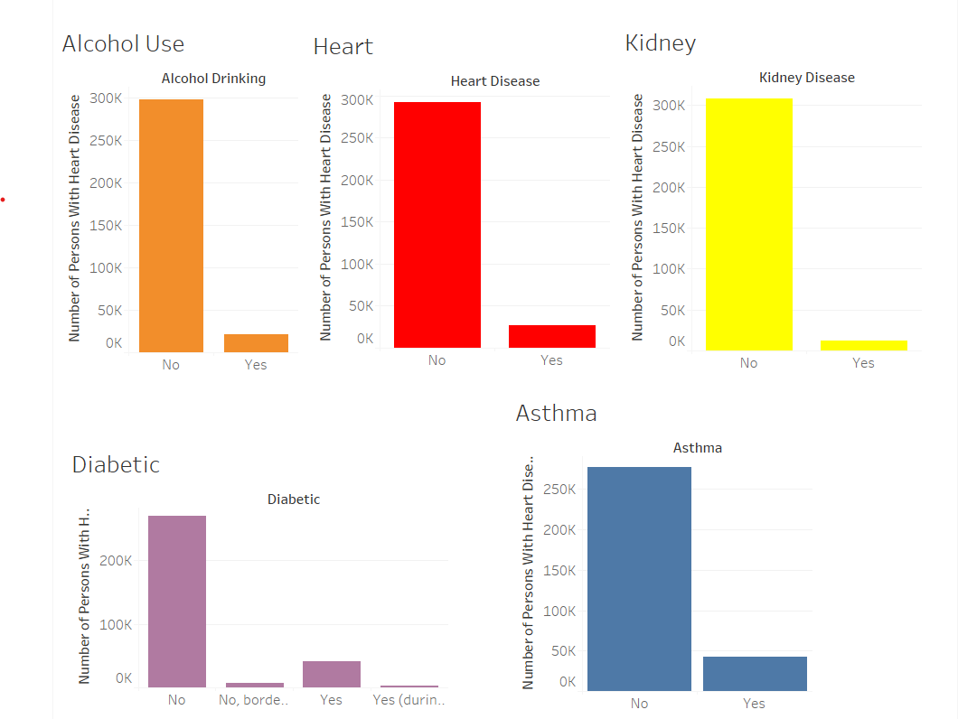
Conclusion
Findings
Tableau Storyboard - https://public.tableau.com/app/profile/ethan.mcbride/viz/HeartDiseaseKeyIndicatorsDashboard/GeneralOverview

Slide 9








The Team
Ethan McBride
Andres Pombo
Sergei Zhukov
Marian Salgadoe
Thank you

